Slide 1





GDSC SOLUTIONS IDEATHON
ReadySeats: Always Find Your Spot
by Team innovisionaries:
Arnav Gupta
Aarnav Gupta
Lipika Bagai
Shachhi Shrivastav

Slide 2


Problem description:
Optimizing Seating Availability in IIT Kanpur Library During Peak Hours
IIT Kanpur's campus library serves as a vital resource for students, offering a conducive environment for study and research. However, during peak hours, particularly leading up to midsemester and end-semester exams, students encounter significant difficulties in finding available seats. This issue disrupts the study routines of many, leading to frustration, decreased productivity as well as time wastage of students.[1]

Slide 3
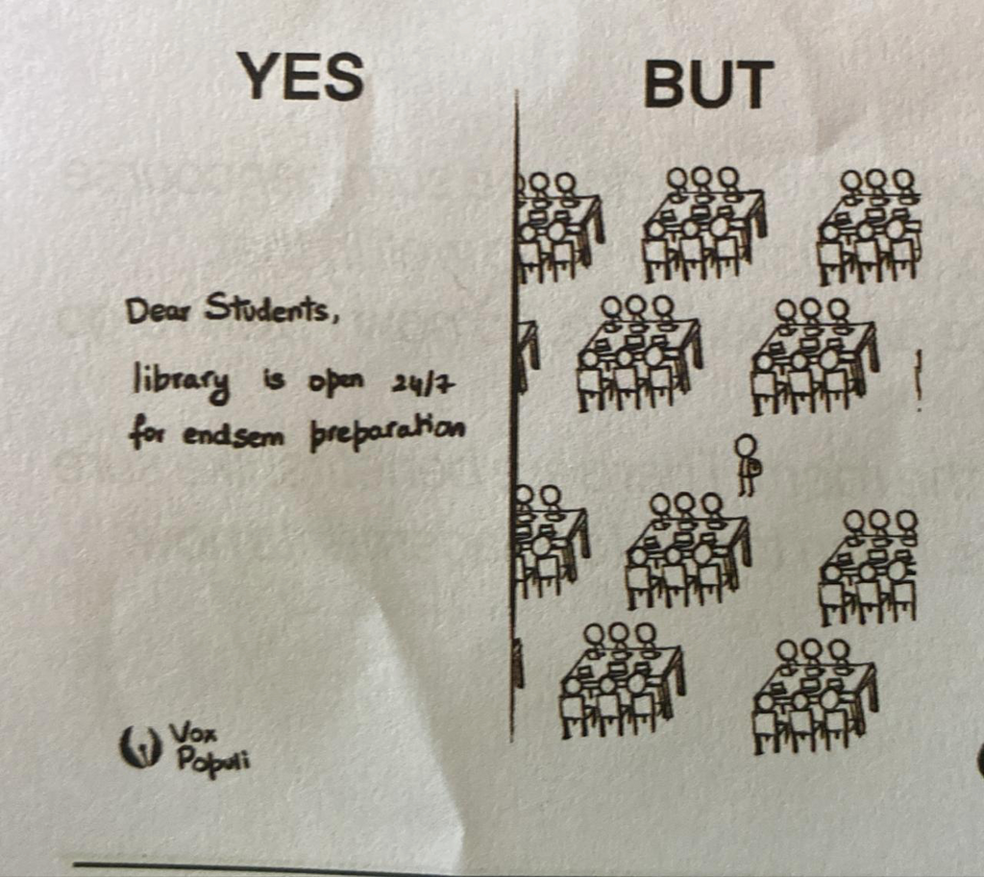
Objective:
The primary objective is to optimize seating availability within the IIT Kanpur library during peak hours, midsemesters, and end-semester exam periods. This involves creating a more equitable, efficient, and comfortable study environment for all students. Since even during the peak hours there are seats that are unoccupied but it becomes arduous for the students to search for the seats for themselves (individually or as in group) on all the three floors of the library.
image credit -vox populi

Slide 4
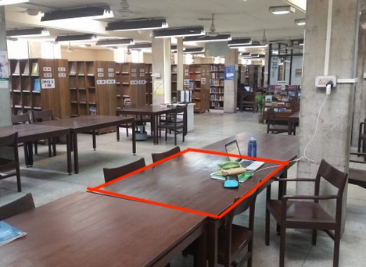

OUR SOLUTION
1)Data Analysis
Upon receiving this data, the system leverages Google's Cloud Vision API for object detection. The primary objective is to identify the table's outline, marking it as a polygon and recording data regarding its boundary points. Furthermore, depth perception and the angle relative to the normal are employed to determine the size of the table accurately. This information enables the system to ascertain the optimal number of cells into which the table can be divided.
The data acquisition process for this library occupancy monitoring system involves the use of cameras positioned on the library's ceiling. These cameras(preferable with high FOV) capture raw data continuously, and new data is transmitted for processing at regular intervals of 5 minutes.
Each individual cell, representing a portion of the table, is subject to occupancy assessment. This determination hinges on the detection of student-related items such as water bottles, notebooks, and other study materials within the confines of each cell. Based on this detection, the system categorizes the cells as either "occupied" or "unoccupied," providing valuable insights into the availability of study spaces within the library.

Slide 5
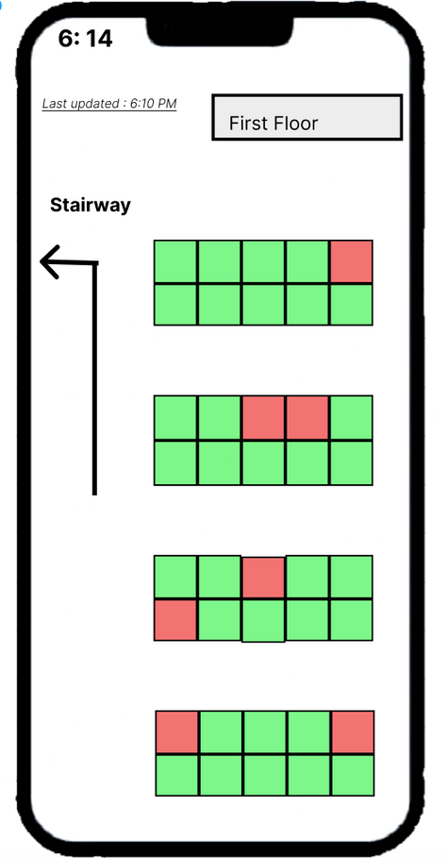
2)Output Distribution
In order to distribute the analysis of the data and indicate which seats are free, we have 2 ideas
Via mobile apps:
On screens within the libraries
We propose a mobile app for the campus janta's convenience. It will offer a comprehensive visual layout of library tables, prominently marking occupied seats in red, ensuring instant identification, while marking available seats in reassuring green.
Upon talking to some senior library officers, we learnt that they would be more than happy to accommodate screens to indicate the location of available seats. By integrating this solution, library patrons will benefit from a real-time, at-a-glance overview of seat availability, contributing to a more seamless and organized library experience across multiple floors.
.

Slide 6


Technical Restraints
There are a few restraints to this solution:
Image distortion: due the the large FOV of the cameras, fisheye distortion, such as the bending of straight lines, is likely. This can be defished using other tools but it adds to the processing burden.
Object Detection: If the table and the student’s belonging placed on the table have similar colours, it may not be picked up by the image detection software as a distinct object and may lead to incorrect display of a vacant seat.

Slide 7
Economic feasibility
There are two types of cost:
Initial cost
Reoccurring cost
75,000 rupees
Installation of cameras and buying cameras
Assuming 12 camera with installation charge
16,000 rupees/month
Google Cloud subscription for processing 12 batches of pictures every 5 minutes
back-end servers for feeding data to mobile application
maintenance costs for cameras

Slide 8
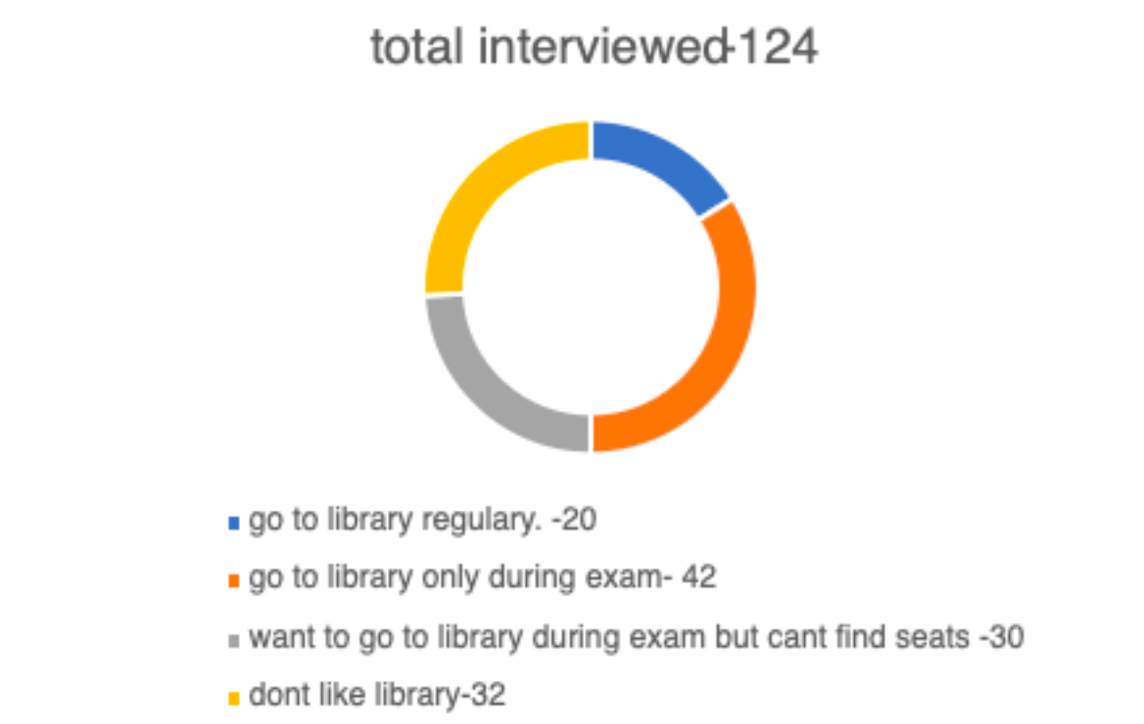
Beneficiaries
The primary beneficiaries of this tech-based solution are the students at IIT Kanpur. They will directly benefit from the enhanced accessibility and efficiency of the library facilities. Additionally, faculty and administrative staff may indirectly benefit from a more streamlined and organized library environment, as it could lead to improved academic performance and reduced administrative burdens related to seat allocation issues.The future students too will get an easy access to library and won’t be facing the dilemma of whether they should study in library or at some other random place in the campus.

Slide 9
Improved Seat Availability:
Impact Metrics:
Before the implementation of this system, students have often faced the challenge of finding available seats within the library, particularly during peak hours, midterms, and final exams. This resulted in a time-consuming and sometimes frustrating process of searching through the three floors of the library for a vacant spot.
With the introduction of smart seat monitoring technology, this situation is expected to undergo a significant improvement. The system continuously tracks and updates the availability of seats in real time, providing students with accurate information about which seats are currently occupied and which are free. This means that students will no longer need to spend valuable time physically searching for an empty seat.
The efficiency of seat allocation within the library will be greatly enhanced. Students will be able to quickly identify and choose from the available seats, maximizing their study time and productivity. This improvement is estimated to lead to a substantial increase in the number of available study spaces, potentially up to 30% during peak hours.
Time Efficiency:
With this smart seat monitoring technology, students will save an estimated 15-20 minutes on average per library visit, as they will no longer need to search for available seats manually. Over a semester, this could amount to hours of reclaimed study time.

Slide 10
Long-Term Benefits:
1. Improved Academic Performance: With more efficient access to study spaces, students may experience an overall improvement in their academic performance. This could potentially lead to an incremental increase in the average CPI across the campus.
2. Potential for Scalability: The technology and approach developed for this solution can potentially be scaled and applied to other areas of campus operations where space availability is a concern
3. Optimized Resource Allocation: The data collected through the system can be used for future campus planning, allowing for better resource allocation based on actual usage patterns.

Slide 11
“Time isn't the main thing. It's the only
thing."
- Miles Davis

